Slide 1
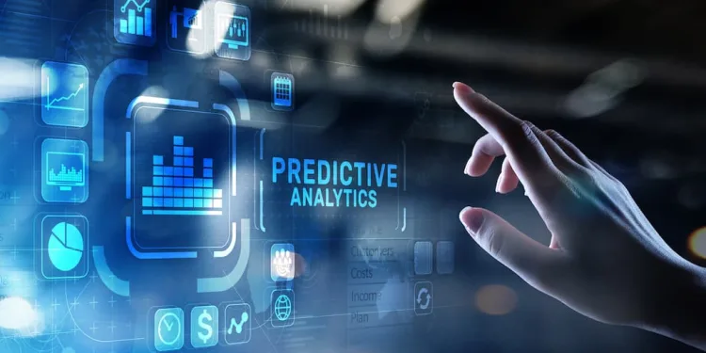

CUSTOMER TRANSACTION ANALYSIS
PRESENTED BY:
VISMAYA M
DATASCIENCE

Slide 2


INTRODUCTION
In today’s data-driven business world, analyzing company transactions is crucial for gaining insights into customer purchasing behavior and financial performance.
This project focuses on applying Data Analysis and Machine Learning techniques to predict customer patterns and derive meaningful insights from the dataset. Through Exploratory Data Analysis (EDA), data preprocessing, visualization, and model building, the objective is to identify key factors influencing outcomes and improve decision-making accuracy.
By developing predictive models, we aim to enhance business strategies, improve customer retention, and support data-driven decisions for better performance.

Slide 3

OBJECTIVE
To analyze customer transaction data to understand purchasing patterns, spending behavior, and usage trends.
To identify key factors influencing customer activity, including product preferences, transaction frequency, and demographic patterns.
To develop predictive machine learning models to forecast customer behavior such as purchase likelihood, segmentation, or churn probability.
To evaluate model performance using appropriate metrics to ensure reliable and accurate predictions.

Slide 4
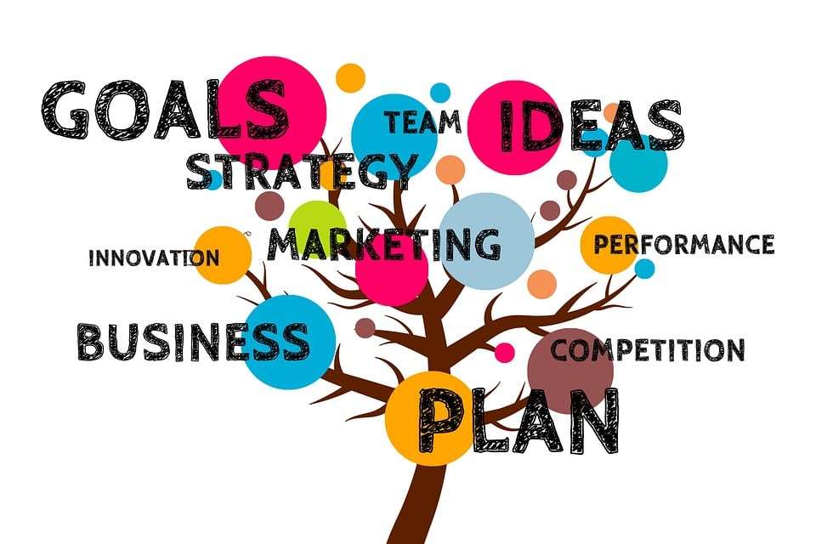
KEY CONCEPTS
Customer purchase behavior
Sales and revenue analysis
Product performance insights
Payment mode and frequency trends
Customer segmentation & loyalty tracking

Slide 5
DATA COLLECTION
Purpose:
The purpose of the topic Customer Transaction Analysis is to analyze customer purchasing patterns, transaction behavior, and revenue insights to support business decision-making and improve sales performance..
Front End(Gradio):
A user-friendly interface allows users to input features like CustomerID, Transaction Date, Product Category, Quantity, and Amount to analyze transaction records and view results easily.
ML Models Used:
Logistic Regression, Random Forest, and XGBoost models were applied to perform customer segmentation, spending prediction, and fraud/anomaly detection, enabling data-driven decision making.

Slide 6
PROCESS OF DATASET
1. Data Collection – Gather customer transaction dataset.
2. Data Cleaning – Remove missing values, duplicates, and outliers.
3. Data Preprocessing – Encode categorical features and scale numerical data.
4. Feature Selection – Identify key attributes influencing transaction patterns.
5. Model Selection – Choose ML models(Logistic Regression, Random Forest, XGBoost).
6. Model Training & Evaluation –Train models and compare performance metrics.

Slide 7
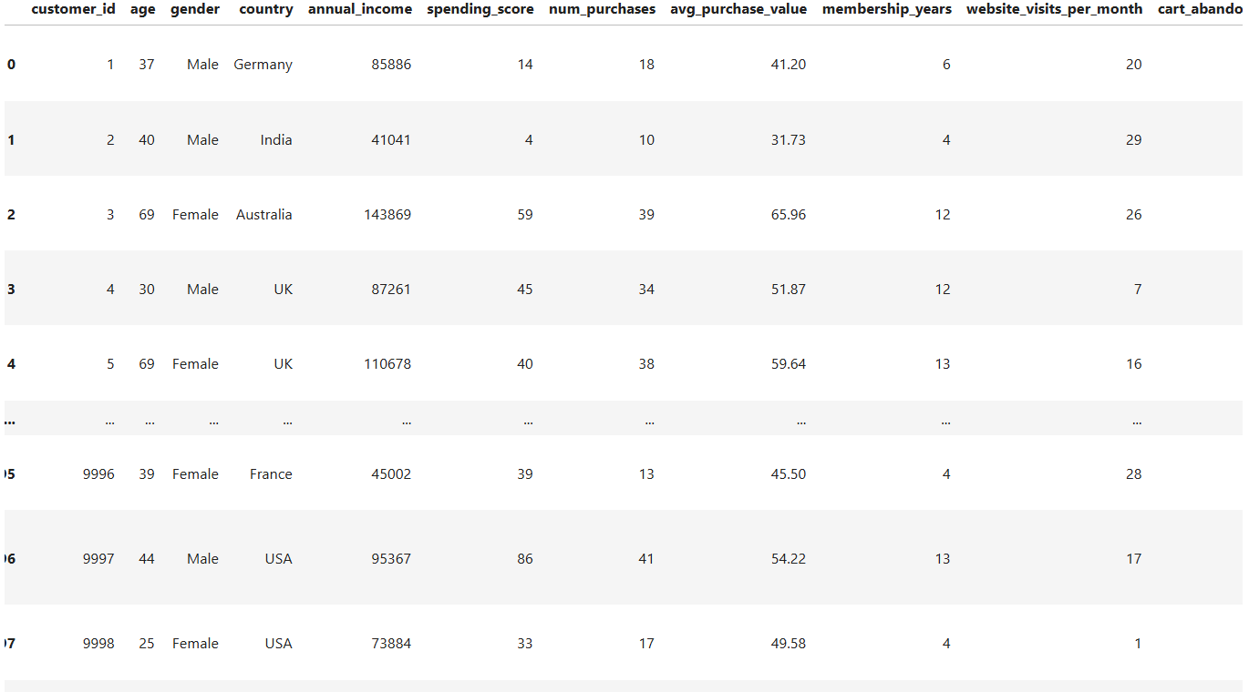
DATASET

Slide 8
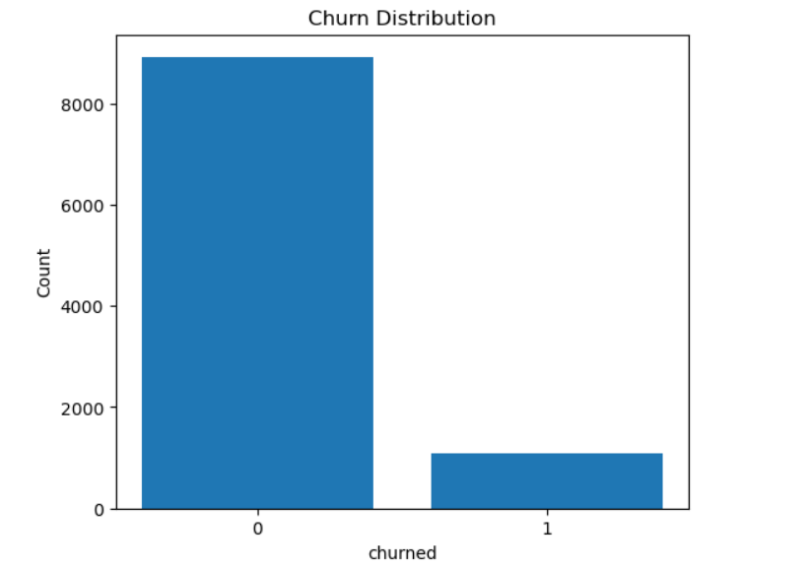
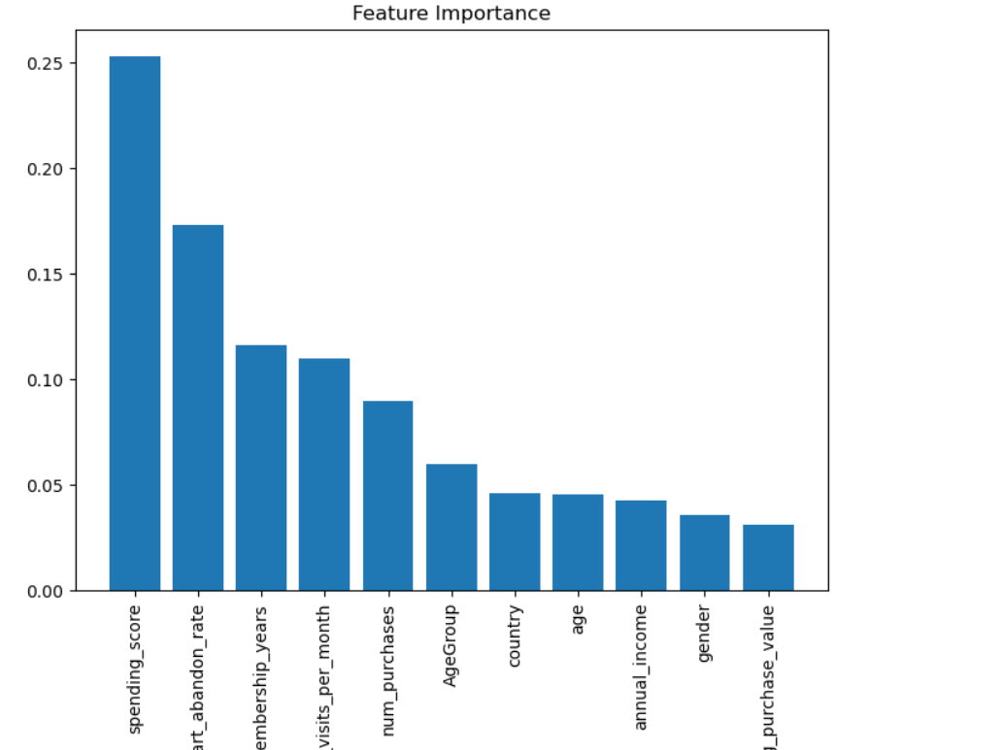
GRAPHICAL OVERVIEW

Slide 9
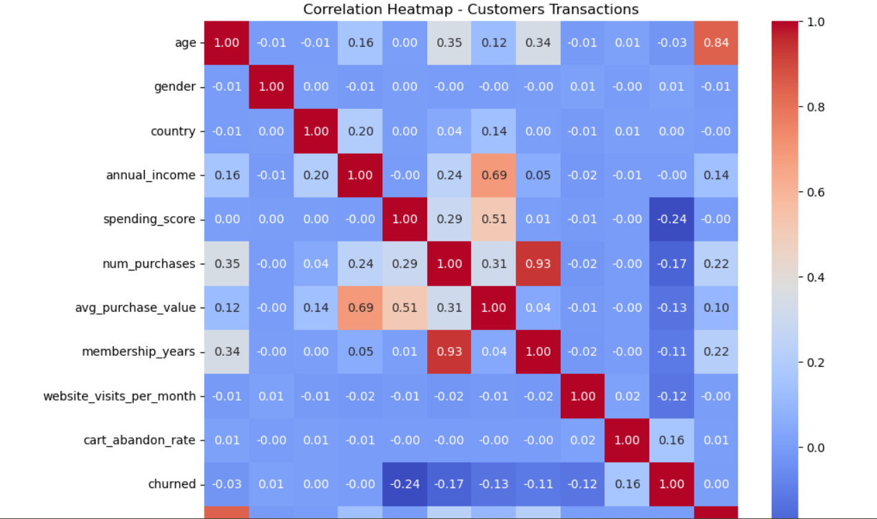

Slide 10
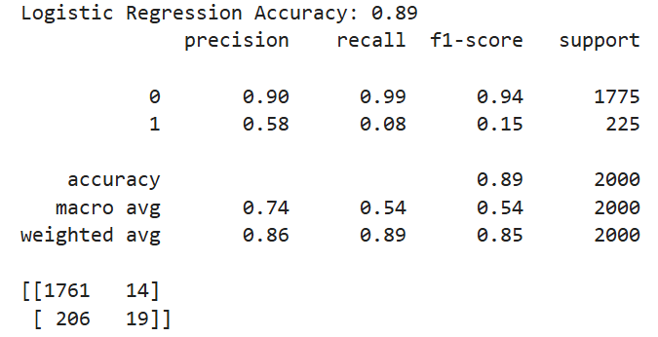
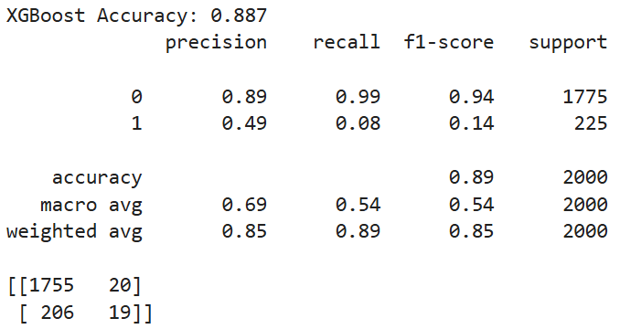
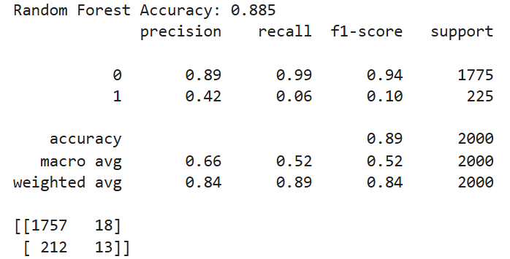
RESULT OBTAINED
Logistic Regression
XG-Boost
Random Forest

Slide 11
COMPARISON TABLE
MODELS | ACCURACY | PRECISION | RECALL | FI SCORE
Logistic Regression | 0.89 | 0.90 | 0.99 | 0.94
Random Forest | 0.885 | 0.89 | 0.99 | 0.94
XG-Boost | 0.887 | 0.89 | 0.99 | 0.94

Slide 12
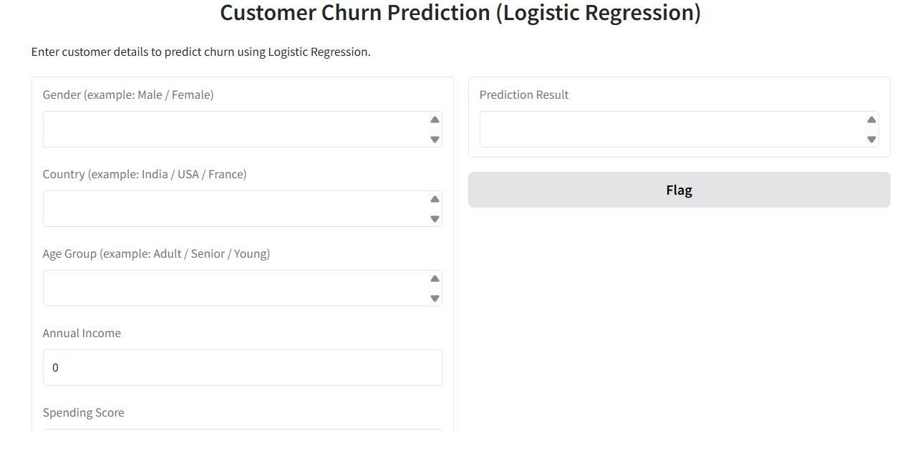
USER INTERFACE

Slide 13

FUTURE IMPROVEMENTS
Integrating Real-Time Transaction Monitoring
Enable live tracking of customer purchases to detect unusual activity instantly and improve fraud prevention.
Better Product Recommendation
Build recommendation models to suggest products based on customer purchase history, improving customer satisfaction and sales.
Advanced Customer Segmentation using Deep Learning
Use advanced neural networks to group customers more accurately based on their behavior.
Interactive Business Dashboard
Create a live dashboard that shows sales revenue trends and customer activity for faster decision-making.

Slide 14

CONCLUSION
The Customer Transaction Analysis project highlights the importance of leveraging transaction data to understand customer purchasing patterns, spending behavior, and overall business performance.
Through machine learning models such as Logistic Regression, Random Forest, and XGBoost, the project successfully predicts customer behavior and potential churn, demonstrating strong accuracy and reliable forecasting. These insights enable companies to take proactive decisions, improve customer retention, optimize product offerings, and maximize revenue growth.

Slide 15

THANK YOU

